Slide 1

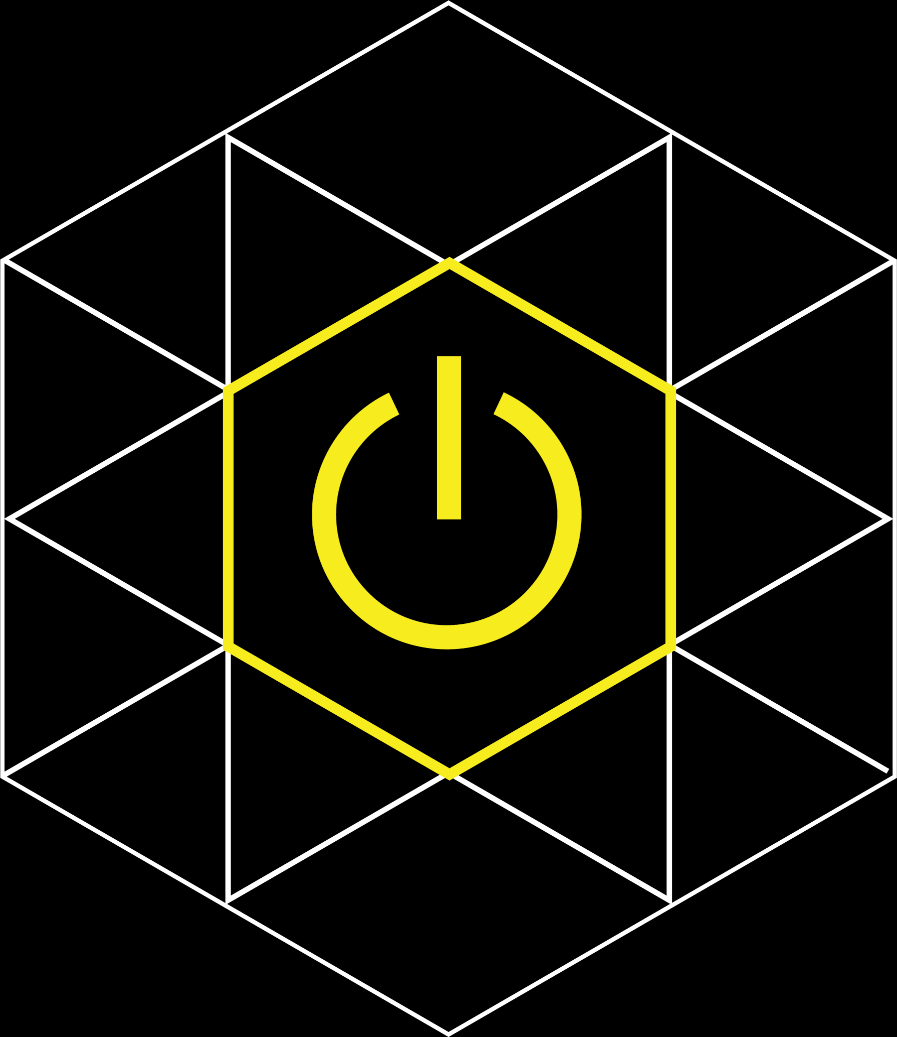
Augmented Reality IoT Gateway
for Better Health

Slide 2
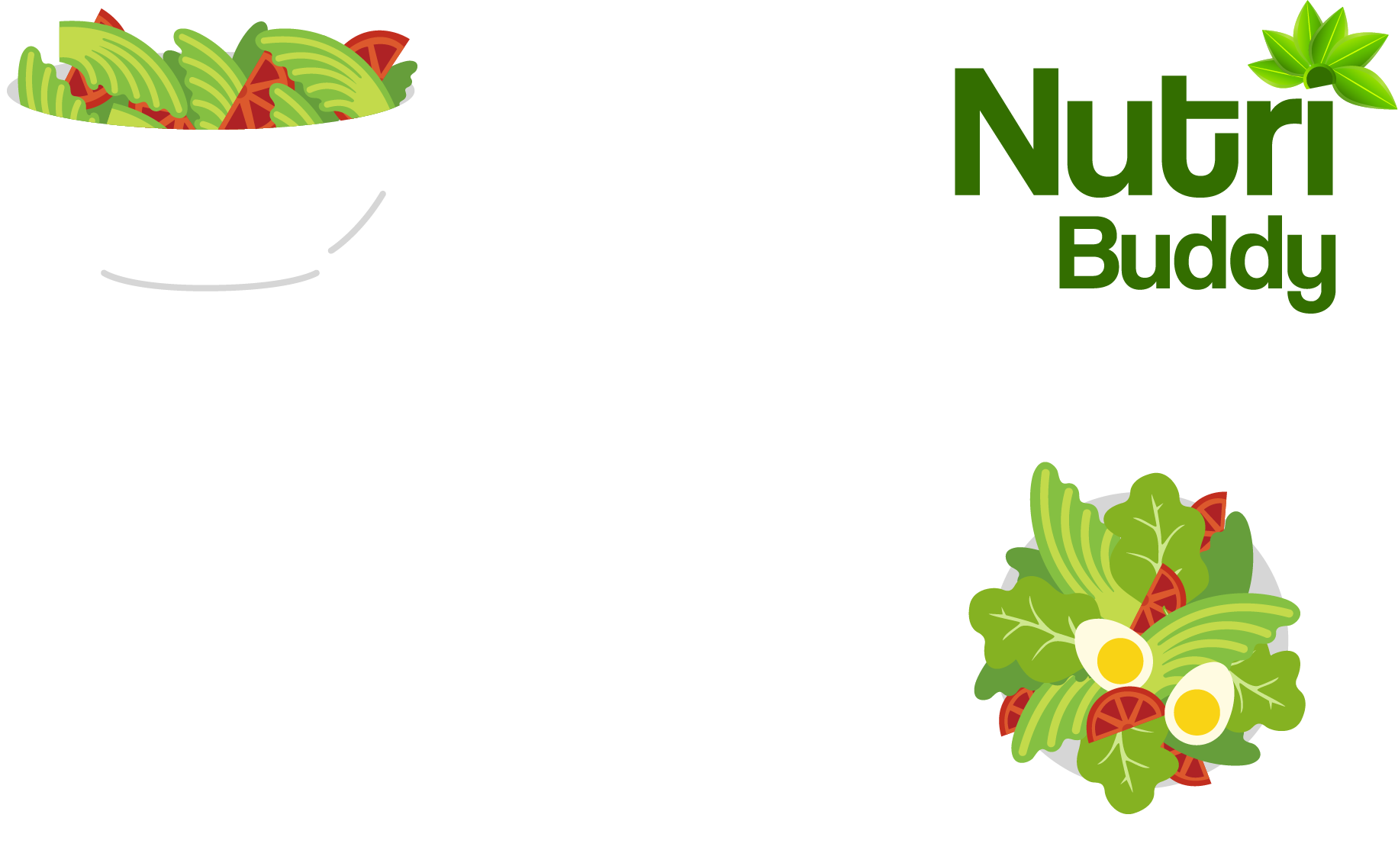
What is NutriBuddy?
NutriBuddy is an app that blocks unhealthy food from peoples vision so they could lead a more focused healthy lifestyle.
Presented by:
Colin Barber
Fozail Ahmad
Lucy Xiang
Alienor Lougerstay

Slide 3
System Architecture
Android Front End for End Users
Snapdragon Server as Backend
IBM Watson API for Image processing

Slide 4

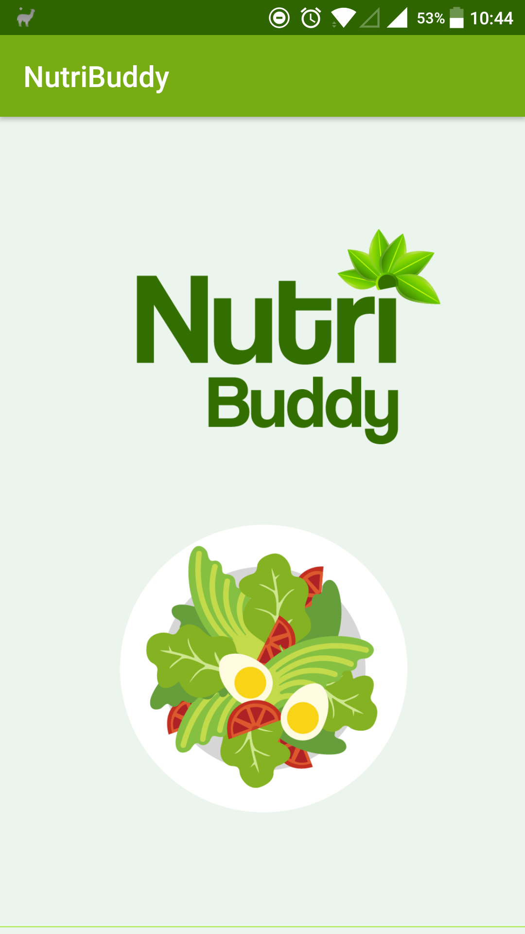
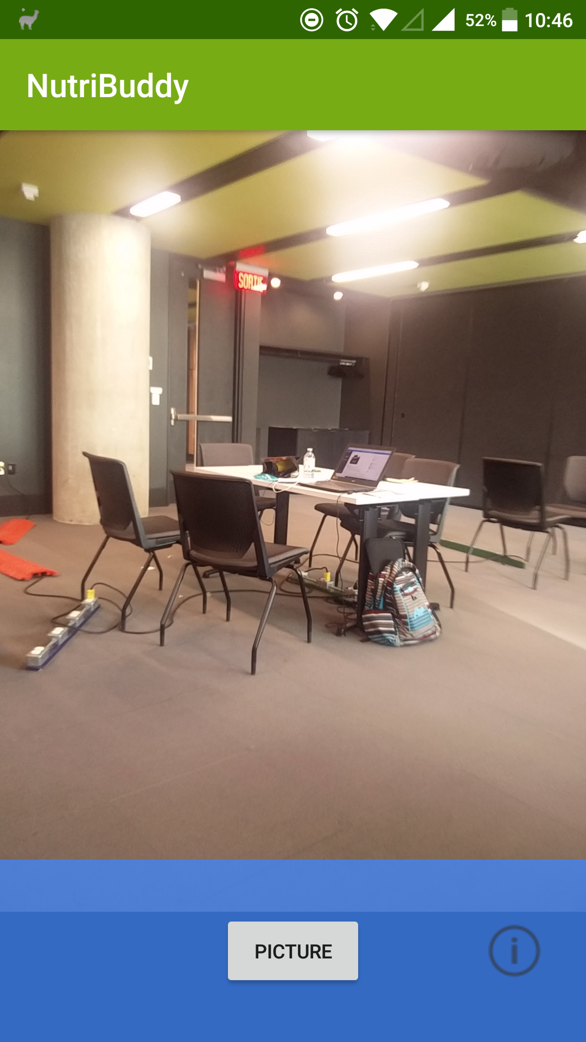
Android Front End
Kotlin Programming
Phase 1:
Camera interface
Single camera shot
Displays extended results
Phase 2:
Live feed – AR oriented
Specific items blocked from customer’s vision

Slide 5
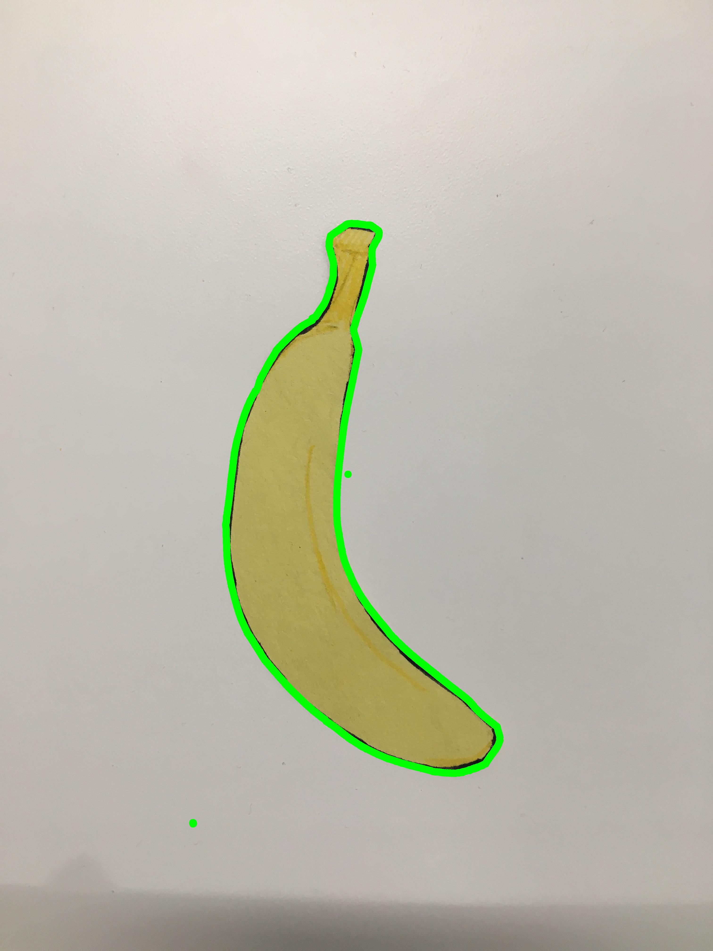
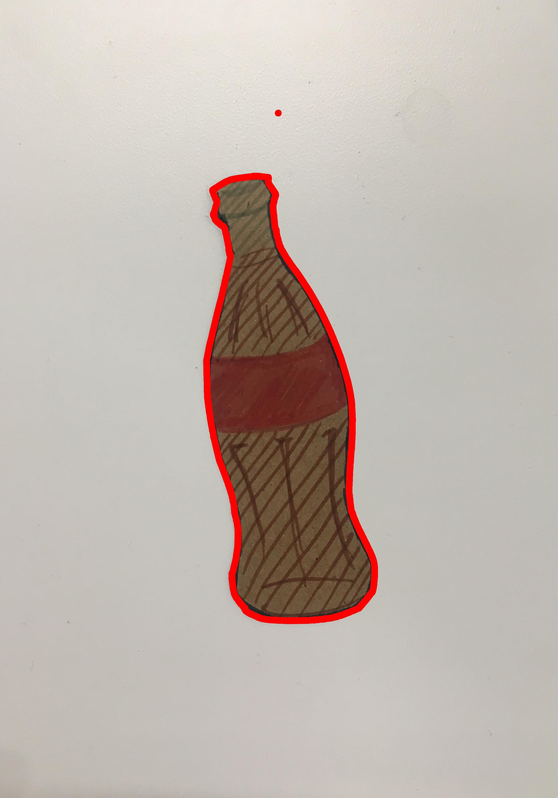
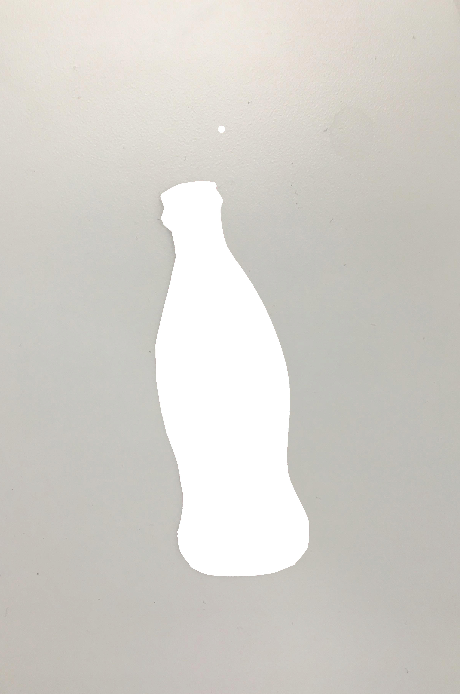

Linux Server
Running on a Snapdragon Qualcomm board
Debian
Python scripts:
Separates image into different objects
Watson IBM for image recognition and sorting
Open CV image processing

Slide 6
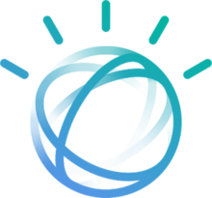
IBM Watson
Handles Image Recognition
Trained for our specific Food Recognition
4 simultaneous instances

